Slide 1
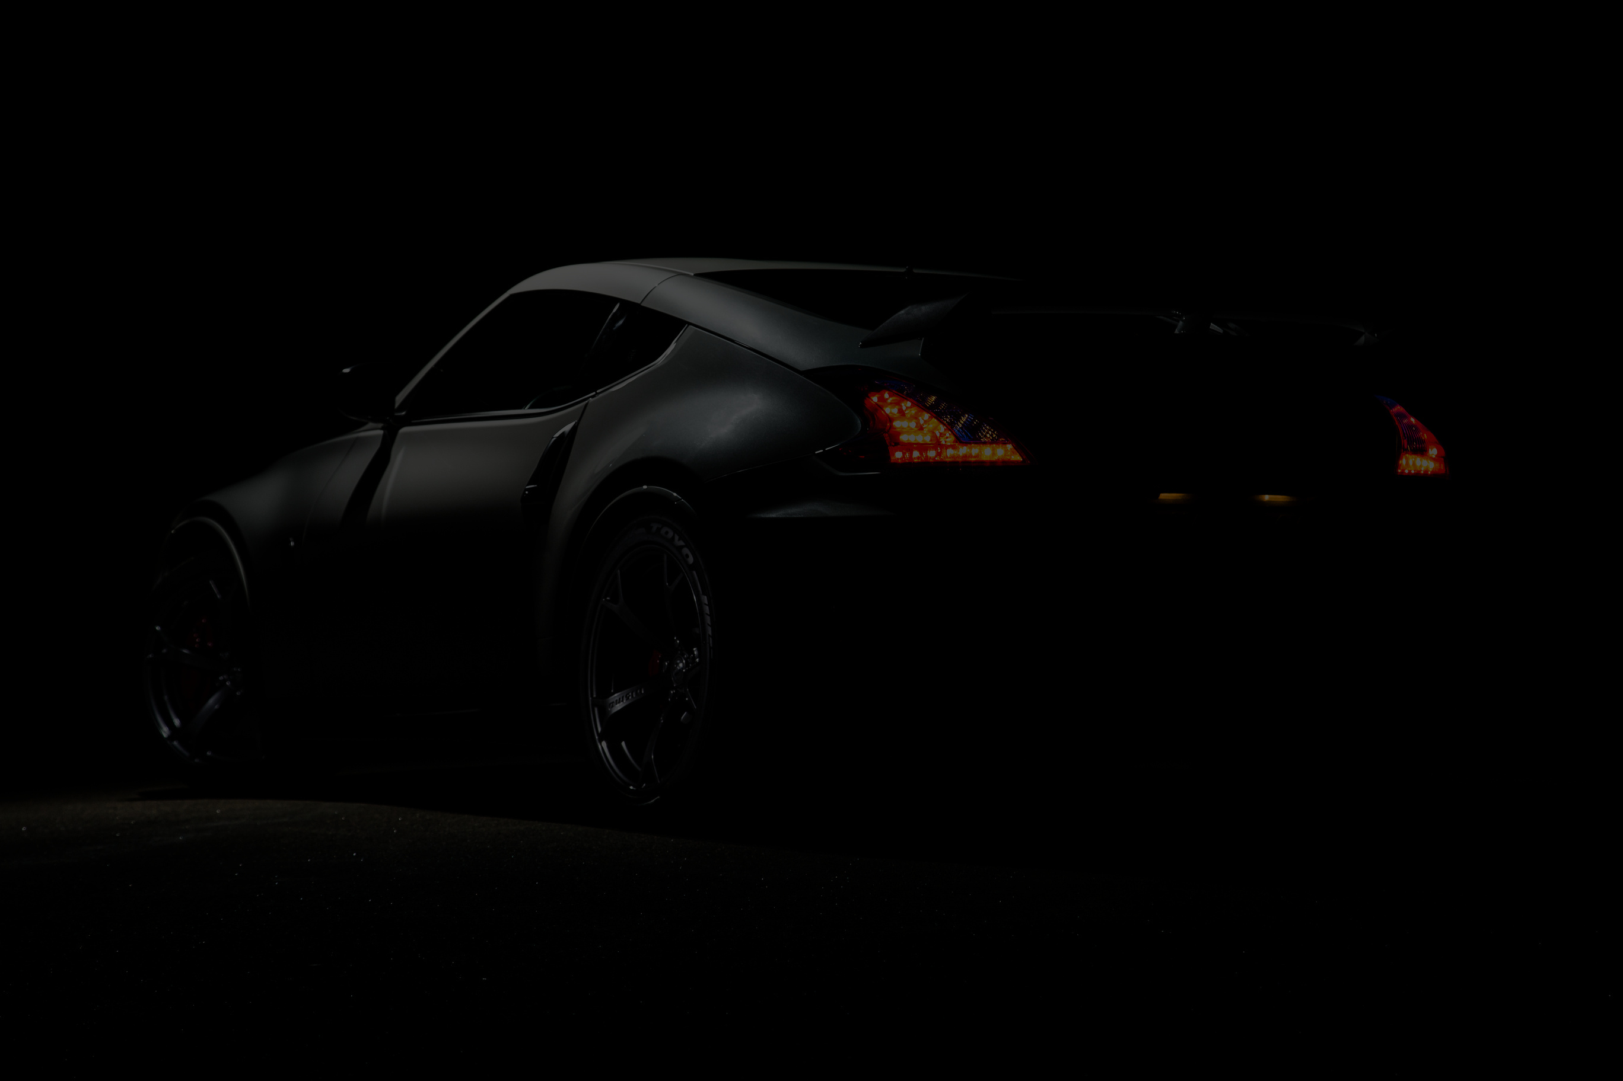


BORCELLE
OPERATING SYSTEM PRESENTATION
Home
About
TOYOTA’S
Contact
next generation cars will be built with
nvidia supercomputer and operating system
Learn More
Next
Get Started
2025 Presentation
Slide
1

Slide 2


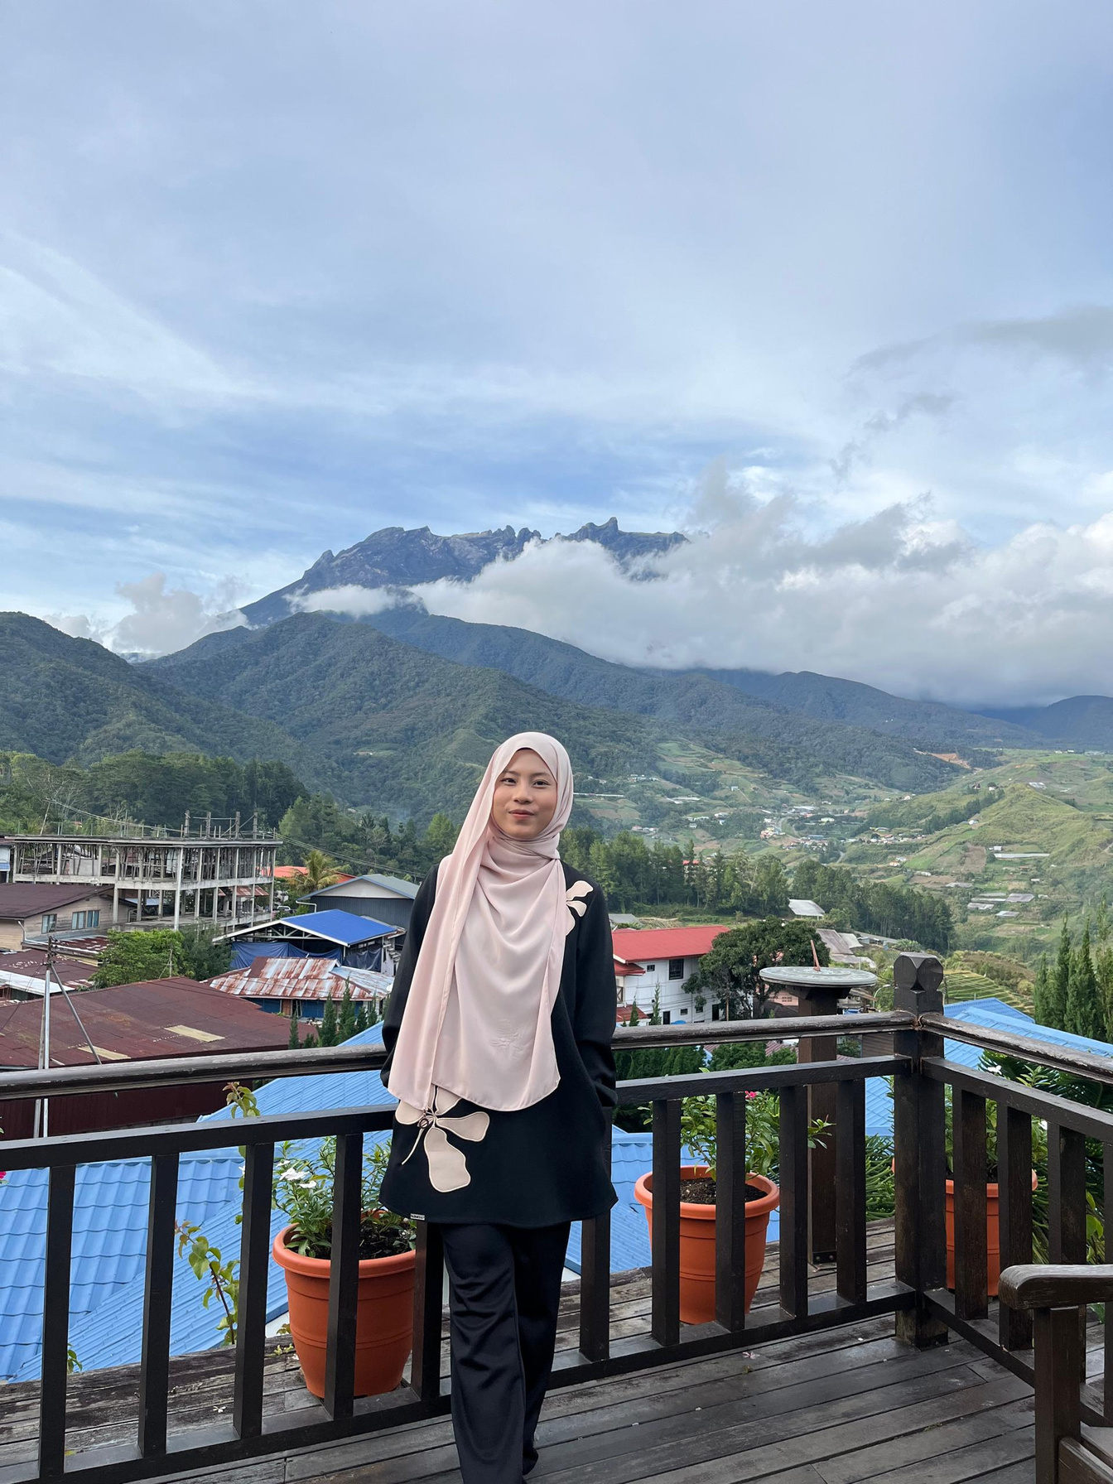
BORCELLE
Home
About
Contact
OUR BEST TEAM
AKMAL ZAFRAN
AKMAL HAZRIQ
ERNIE SHAZRIN
2025 Presentation
Slide
2

Slide 3

BORCELLE
Home
About
Contact
INTRODUCTION
Super computers at NVIDIA powering the next-generation automobiles at Toyota
Partnership of Toyota and NVIDIA is put in place with the main focus of creating a transport option which would be more efficient, safe, and wise
Roadmap positioning at pioneer in SDV technology
Sustainably meet improvements for end usability
Learn More
2025 Presentation
Slide
3

Slide 4
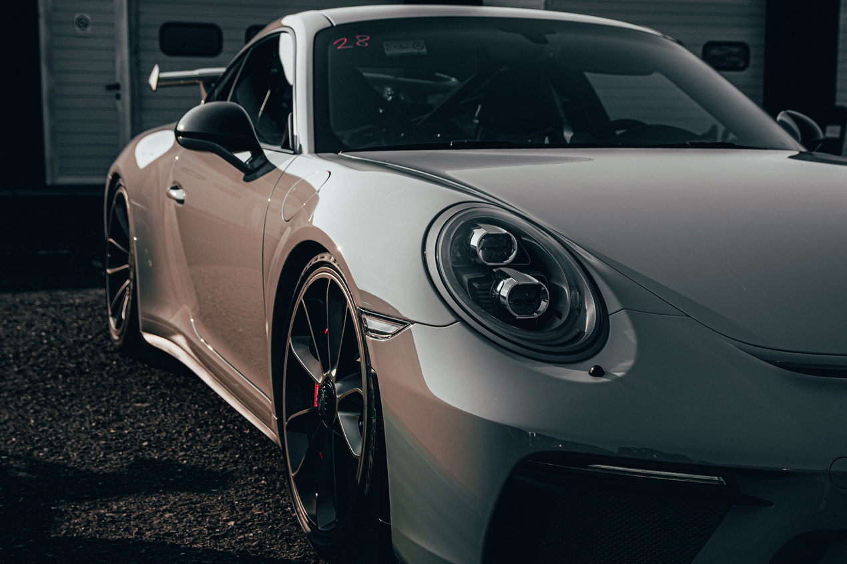
BORCELLE
Home
About
Contact
ISSUE IDENTIFICATION
Project involves integration of advanced hardware, software, and data protection systems
Toyota intends to revolutionize vehicle-environment and vehicle-passenger interaction
Main challenges are government compliance, consumer affordability, and edge computing features
Learn More
2025 Presentation
Slide
4

Slide 5
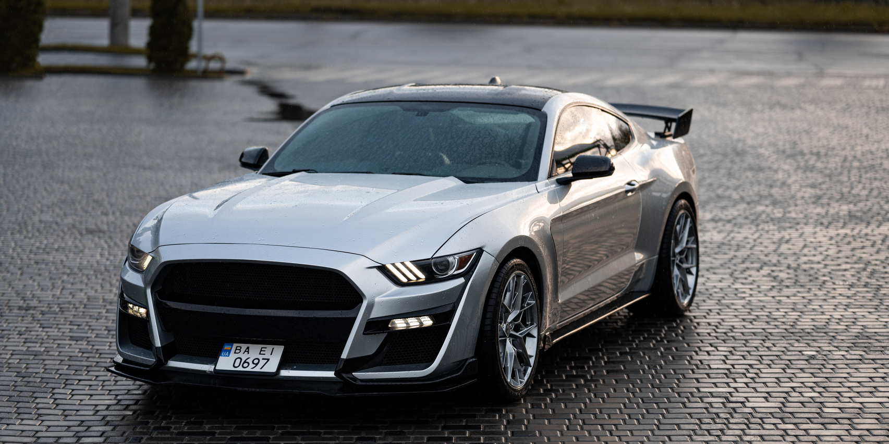
BORCELLE
Home
About
Contact
DEFINITION
Software-defined vehicles reflect new frontier in automobiles
SDVs consist of intelligent computing units and network-based operations
System capabilities span from simple tasks to autonomous driving
Learn More
2025 Presentation
Slide
5

Slide 6
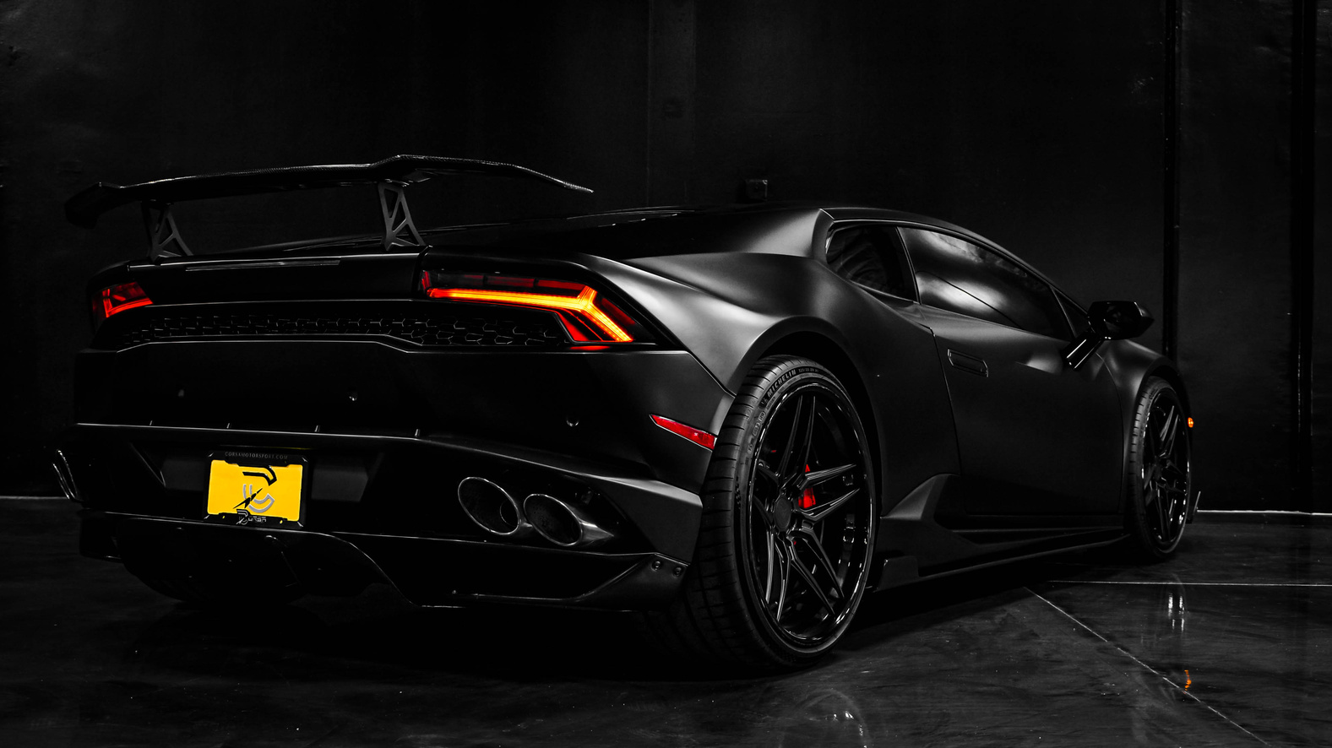
BORCELLE
Home
About
Contact
TECHNICAL REQUIREMENTS
Need for fault-tolerant
vehicle computing environment :
System has to process real-time data from sensors and cameras
High-performance hardware with adaptive software is required
2025 Presentation
Slide
6

Slide 7

BORCELLE
Home
About
Contact
ADVANTAGES AND DISADVANTAGES
Energy management and operational efficiency
Climate change initiative and sustainable development
Software updates can be continuous without changing hardware
Security: Potential cyber-attack, data protection
Opportunities for various applications in automotive
Learn More
2025 Presentation
Slide
7

Slide 8
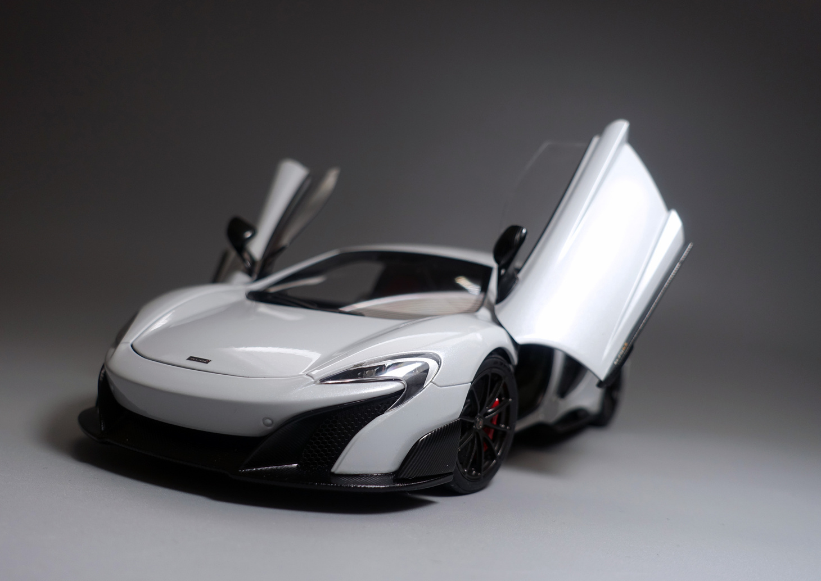

BORCELLE
Home
About
Contact
EXPERT OPINION
SDVs are the next evolution of the industry, confirms NVIDIA Chairman Jensen Huang
Scalable supercomputing infrastructure is required
Toyota's management perceives this partnership as the door to future mobility
This collaboration demonstrates successful tech-manufacturer collaboration
2025 Presentation
Slide
8

Slide 9
BORCELLE
Home
About
Contact
IMPLEMENTATION DETAILS
Utilizes NVIDIA DRIVE platform for autonomous vehicles
Embedded AI, machine learning, and parallel computing
Virtual testing enabled by NVIDIA Omniverse™
Real-time processing of data to dynamically adjust vehicle behavior
Capable of over-the-air updates to continually improve performance
2025 Presentation
Slide
9

Slide 10
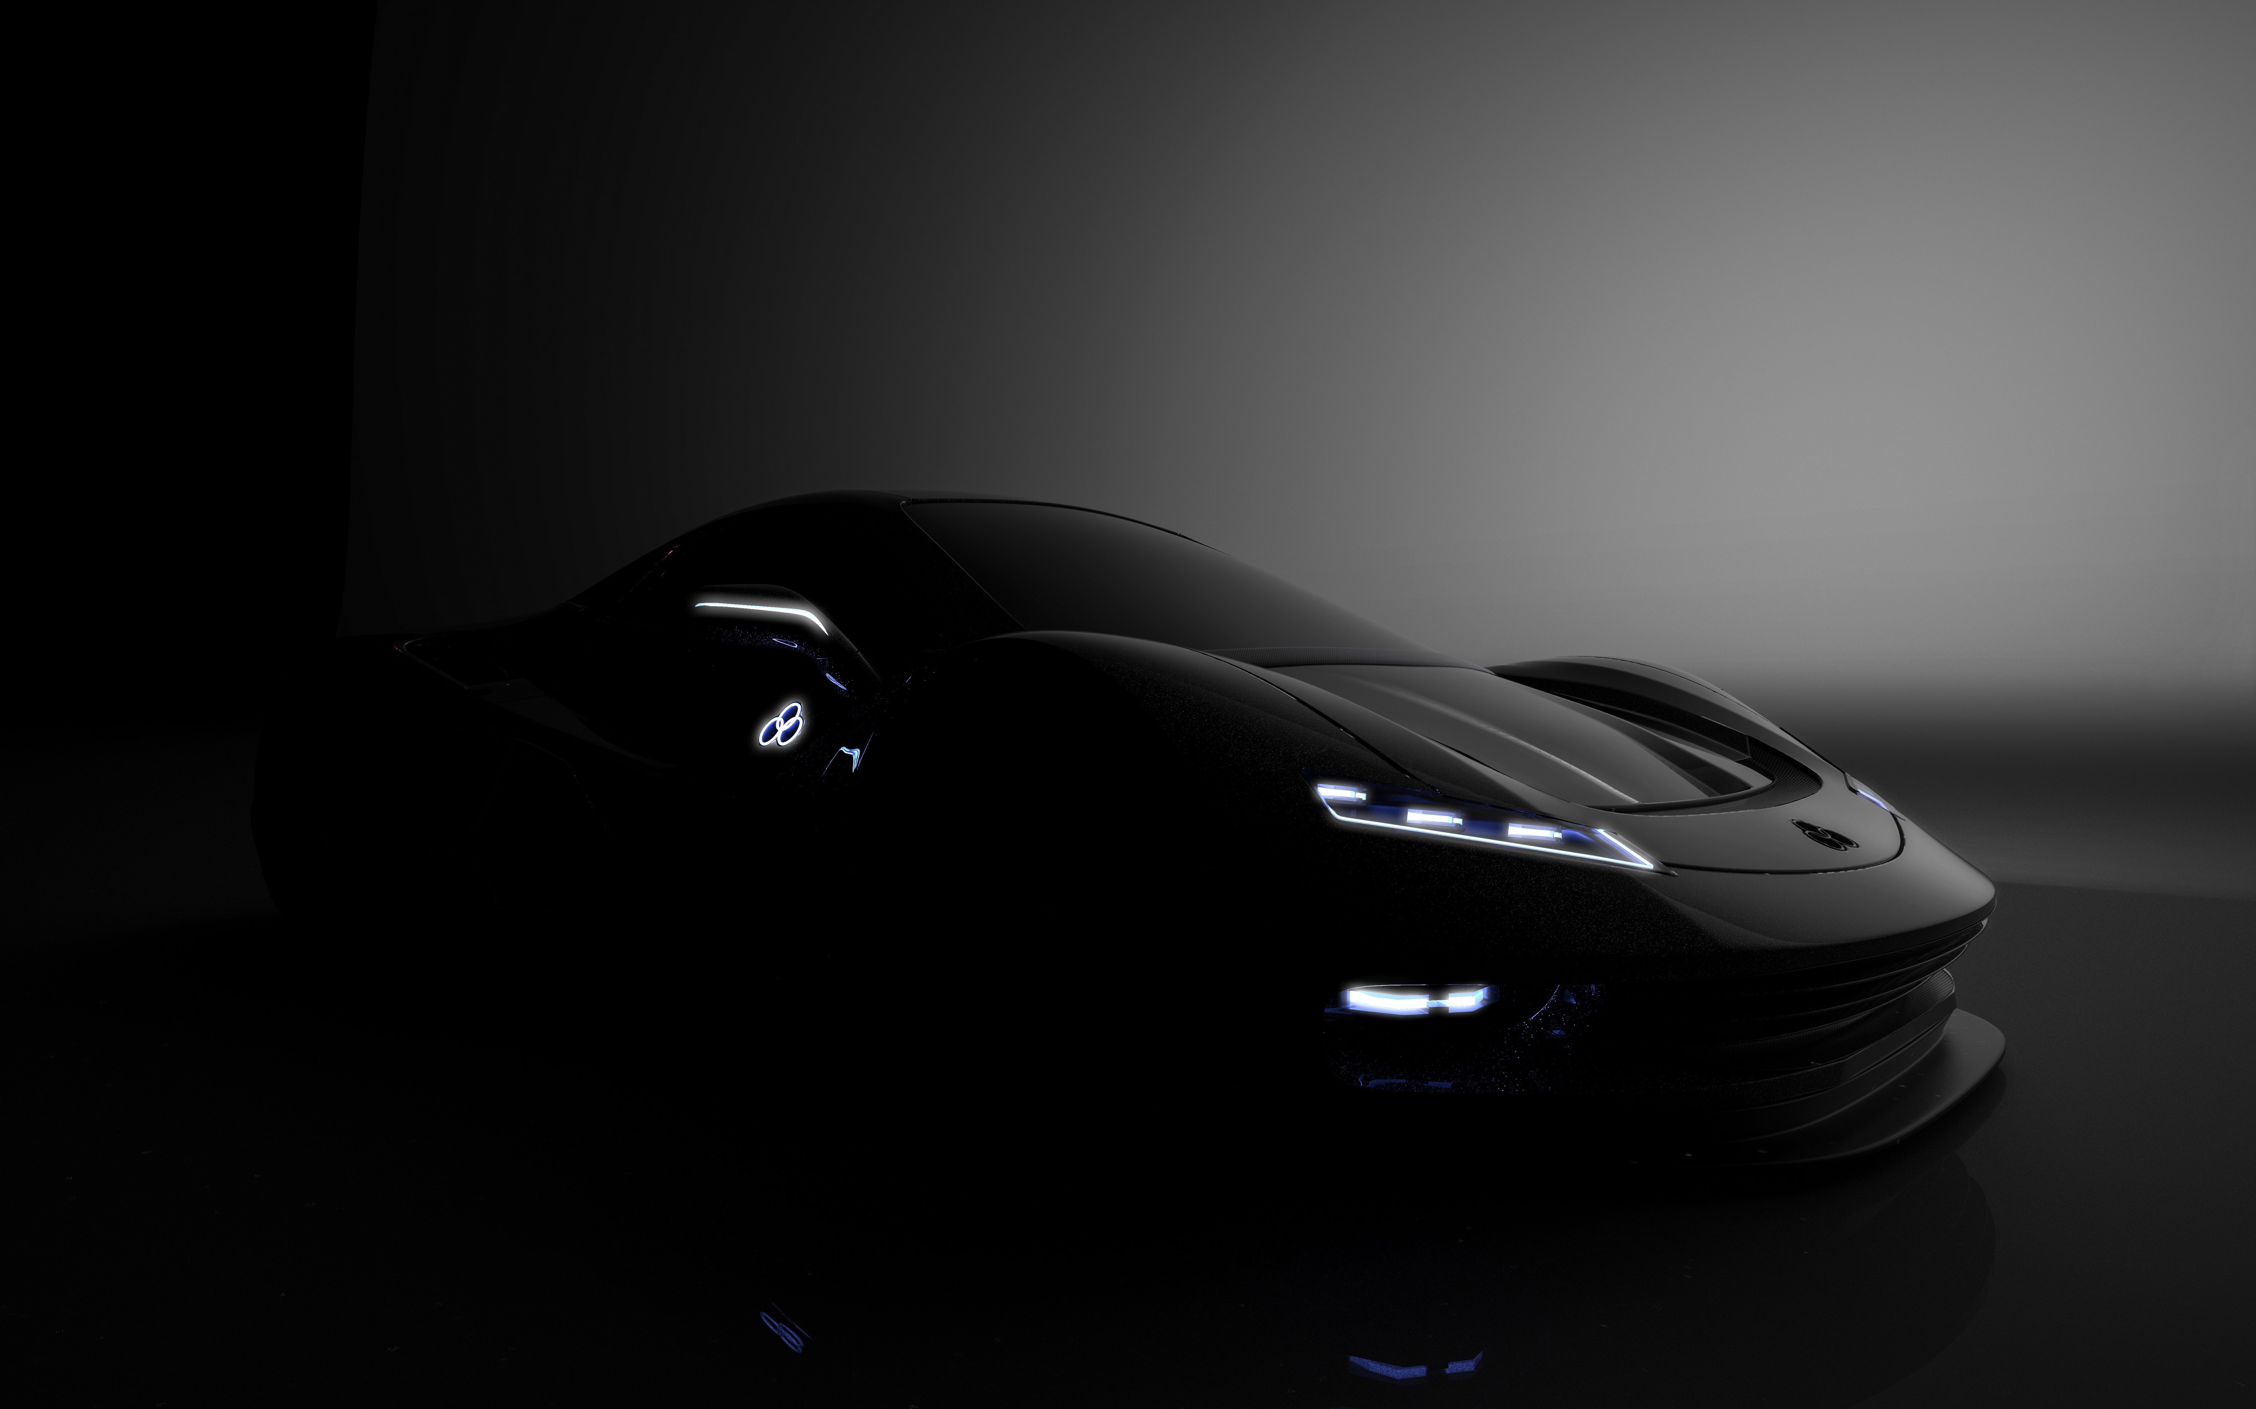
BORCELLE
Home
About
Contact
CONCLUSION
The partnership is one step toward software-defined vehicles
Sets industry benchmark for innovative, safe, and sustainable design
Poised to accelerate industry-wide adoption of similar technologies
Demonstrates what can be achieved by cross-industry collaboration in the service of society
2025 Presentation
Slide
10

Slide 11
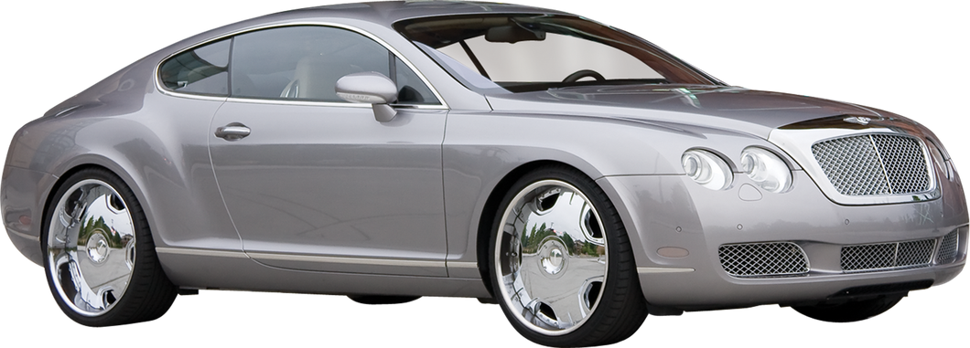
BORCELLE
Home
About
Contact
THANK YOU
Learn More
End
2025 Presentation
Slide
11

